Slide 1



Programming for IoT applications
Carmen De Giovanni
Dario Ditano
Rosario Galazzo
19th September 2020

Slide 2



We usually think our home is the most secure place in the world, and it is true.
But what about home burglaries and house fires?
The most popular of these "home accidents" is home theft, caused by experienced or inexperienced burglars.
Although this event does not physically affect the unfortunate, the burglary in the house causes psychological injury to the latter and it will feel insecure in its home.
Introduction

Slide 3
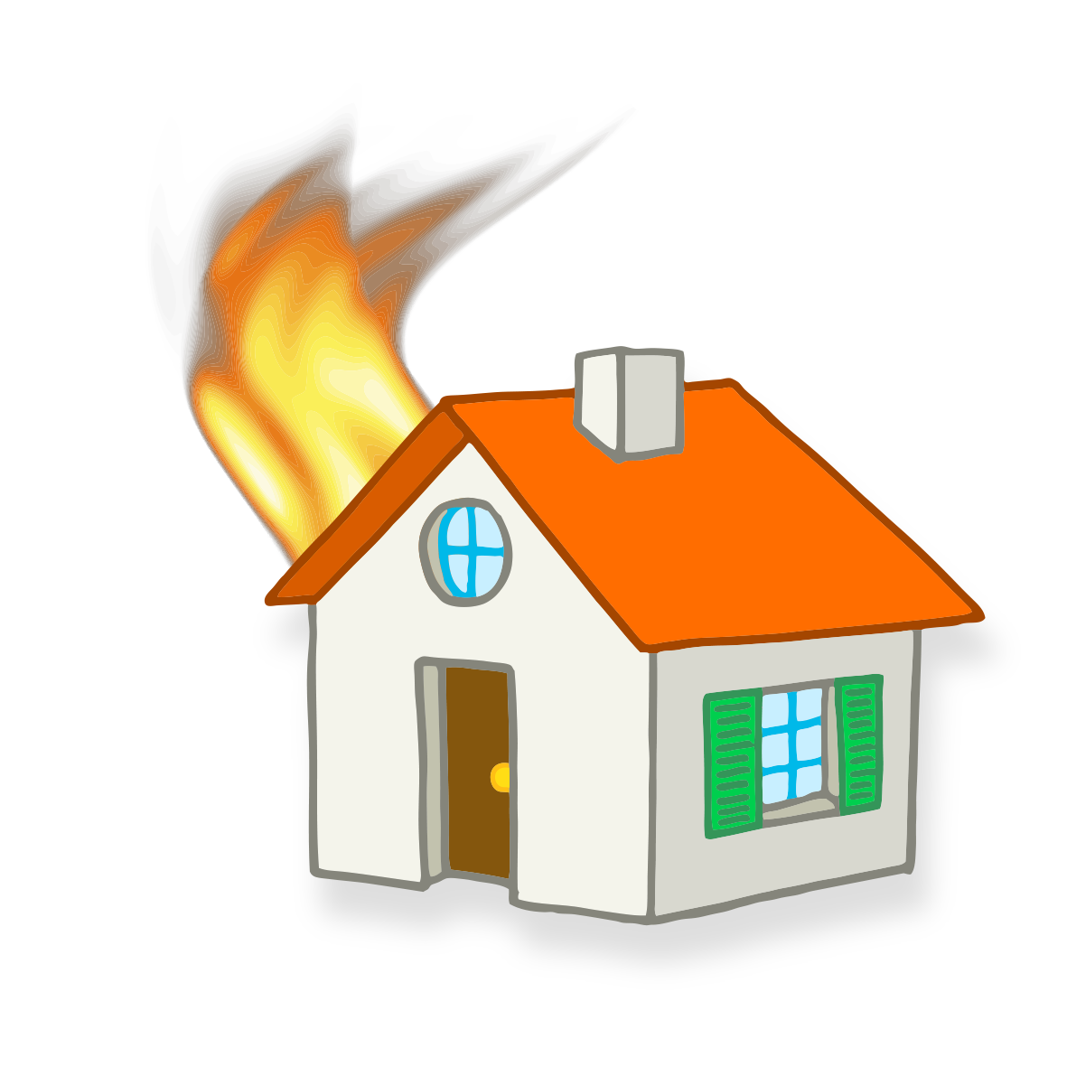

The second home accident is house fire.
The main cause is a gas leak, and it can happen in many situations:
You go to work and forget the gas on
Your baby turns on the gas
A gas pipe suddenly breaks
There is a fire in the building
Furthermore, if you are unlucky, the apartment thief is also a pyromaniac!
Both accidents cause an huge economic loss and sometimes in case of home fire it is possible to be seriously injured.
”Prevention is better than cure“
Stop a fire or a home burglary very soon to save our home is the best act we can do.
How? Take a smile.
Introduction

Slide 4

TakeASmile is a modern home security system created to detect intruders and fires.
Two types of notification:
The system detects a human intruder and take photos.
The system detects too high concentration of explosive gas.
TakeASmile

Slide 5
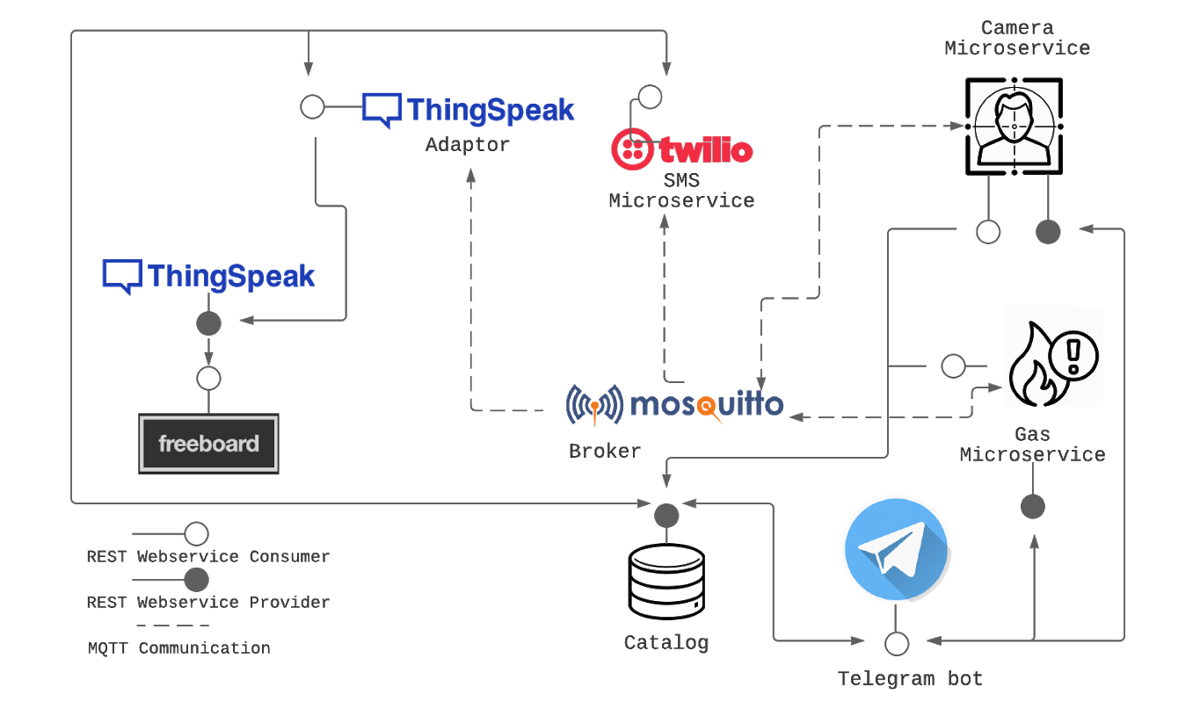
Architecture

Slide 6
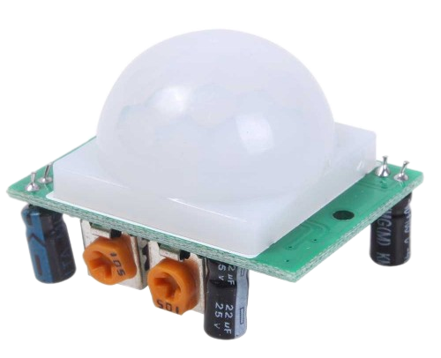
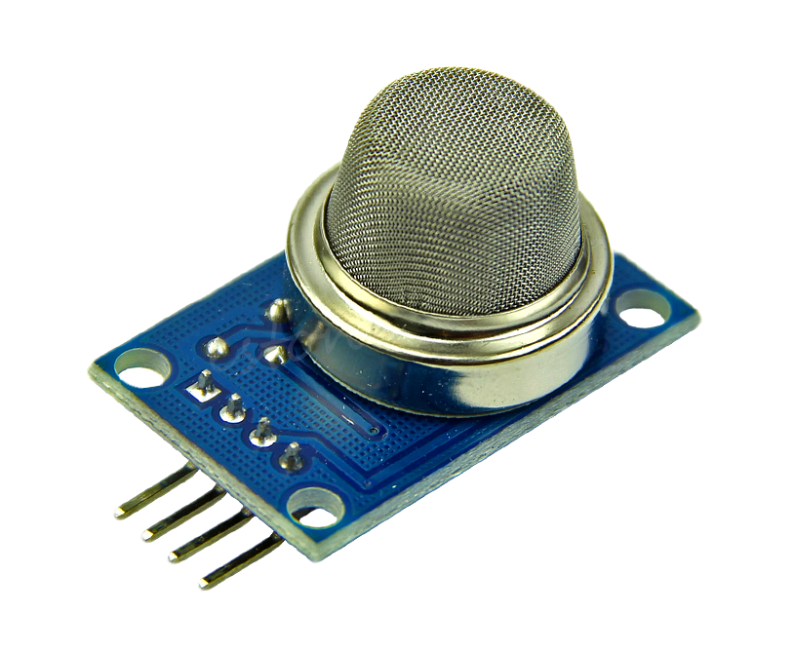

There are two sensors in the system:
A sensor to detect movement
A sensor to detect the level of explosive gas in the air.
These sensors are connected to Arduino, which through MQTT communicates every survey on the network.
A detected movement activates a camera, mounted on a Raspberry, that uses an object recognition algorithm.
If a human is identified, the alarm will be sent.
Recognition of human beings is important to avoid false alarms due to pets.
Hardwares

Slide 7

The user can monitor the situation through a Telegram bot, which he can access after an initial login.
Monitoring can be done in any place, via smartphone or PC, and the only constraint is having the internet. But what if there is no internet?
For this eventuality, an SMS microservice has been designed, which can notify the most dangerous situations together with Telegram.
Communications

Slide 8

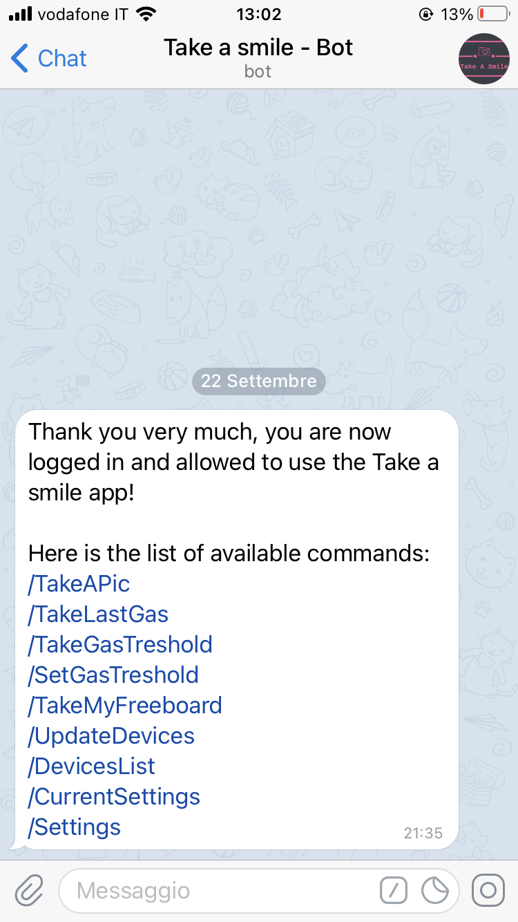
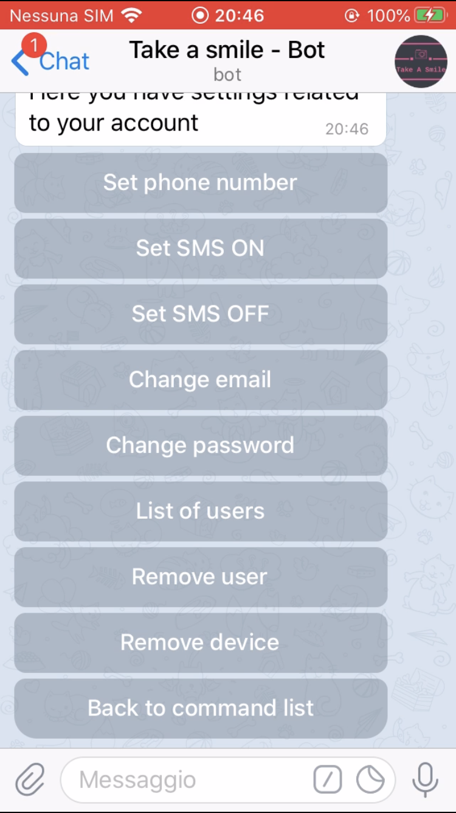
Through the telegram bot the user can perform various actions, but in particular he can take a photo to monitor a pet, or he can change the threshold for the gas notification.
Telegram Bot
In addition, through numerous options, it is possible to manage the various users who access the bot and your account.

Slide 9
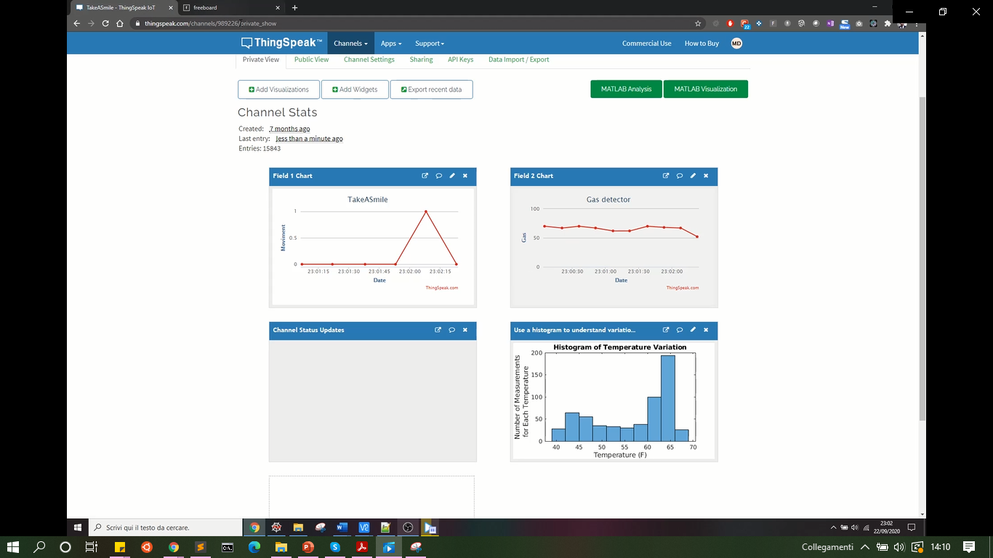
The status of the sensors is continuously communicated to ThingSpeak, an online platform where it is possible to keep them in memory and subsequently view them through graphs that represent the trend.
ThingSpeak

Slide 10
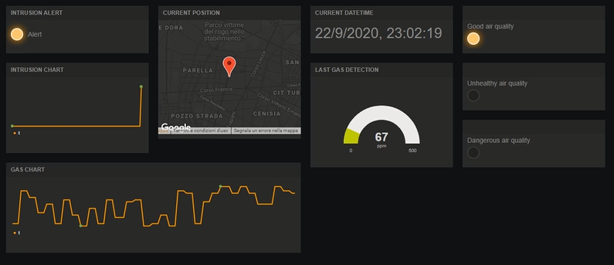
The user can also view the progress of home monitoring in a dashboard built with freeboard.
On the left, a light on will indicate motion detected, while on the right, the lights will indicate air quality.
Freeboard

Slide 11
This IoT platform is:
Modular-Interoperable: the system is designed as a collection of interoperable components, and each microservice is independent of the others.
Scalable: the system is able to manage various devices, users, and data exchanged (with the possibility to add and remove other devices).
Secure: Users authentication through password and email, REST API Digest authentication, encrypted telephone numbers.
Easy to use: the controls of the telegram bot and the dashboard are intuitive and easy to understand.
Conclusions

Slide 12

Currently the system is ready to add more cameras, other gas detectors, and other motion sensors.
What is missing is a light that can be switched on together with the camera, or in certain time slot that can be set by the user.
A light can be very useful at night or for dark rooms, and requires very little effort to implement.
Future Developments

Slide 13
Thank you for the attention

